Slide 1
Defensive Security Project
by: Manuel Vélez Pichardo

Slide 2
Table of Contents
This document contains the following resources:
Monitoring Environment
• A visual environment to monitor and track any suspicious activity throughout the network.
• Alerts if specified activity has been detected.
Attack Analysis
Analyze and understand attacks on a network.
Project Summary & Future Mitigations
• Create ways to mitigate attacks in the future

Slide 3

Monitoring Environment
‹#›

Slide 4
Scenario
In this scenario, Visual Space Industries (VSI), a VR programing business, has heard rumors that their competitor, JobeCorp, will launch a cyberattack to disrupt VSI’s business.
VSI’s SOC Analyst was tasked to create a visual environment (dashboard) to compare past daily business logs to create a baseline between normal daily functions and suspicious activity and compare them with the logs from the timeframe of the attack.

Slide 5
Logs Analyzed
Windows Logs
Apache Logs
1
2
• Past logs contained normal day-to-day business functions such as successful/failed logins, deleted/created accounts, lockout alerts, etc.
• Logs from the suspected time frame of the attack were compared to to past logs to differentiate any abnormal activity. These contained unusual amounts of login attempts and modifications of user accounts.
• Past Apache logs also contained day-to-day website traffic data. These included the country of HTTP methods, country of origin, URI data, to name a few. These were also compared to the suspected day of attack to point out any noticeable unusual activity.

Slide 6
Windows Logs
‹#›

Slide 7
Reports—Windows
Designed the following Reports:
Report Name | Report Description
Signature and IDs | Events going on in a Windows systems.
Severity Level | Indicates the counts of security-related events.
Success and Failed Activities | Provides the amount of times user have either failed or succeeded to login in their accounts.

Slide 8
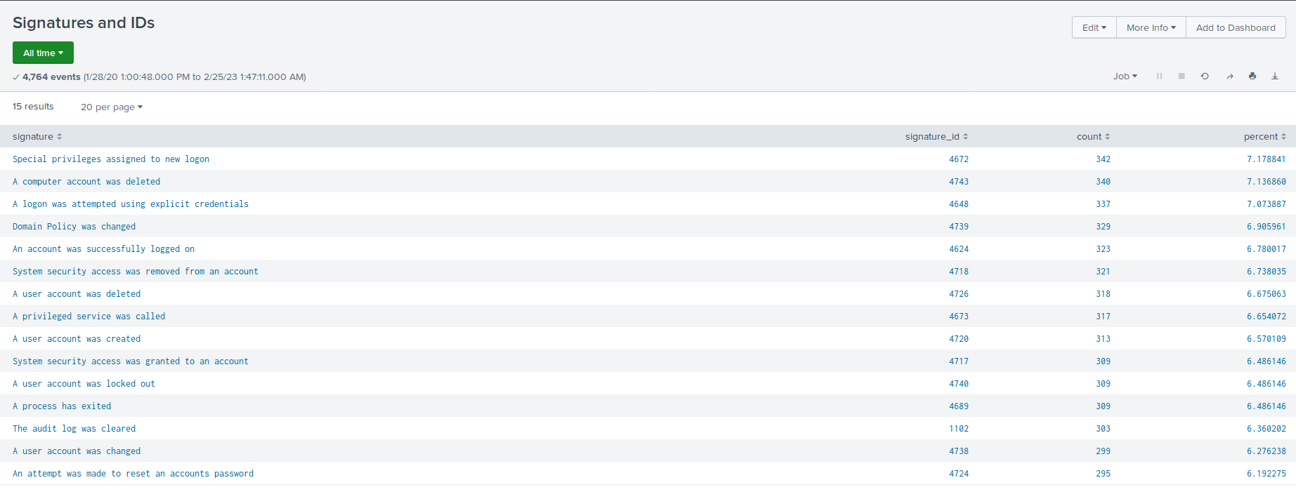
Images of Reports—Windows

Slide 9
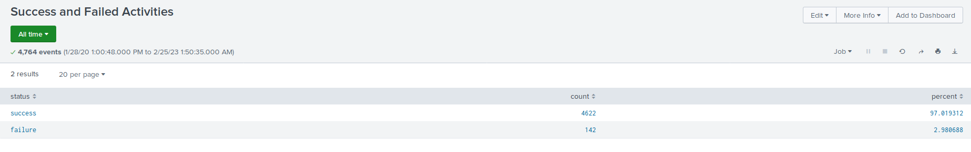
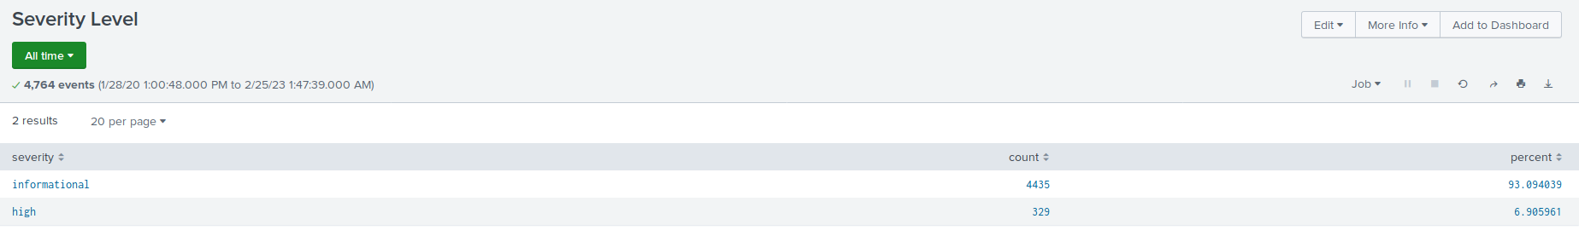
Images of Reports—Windows

Slide 10
Alerts—Windows
Designed the following alerts:
Alert Name | Alert Description | Alert Baseline | Alert Threshold
Exceeded Failed Logins | Triggers an alert if it detects too many failed logins on user accounts throughout the network. | A normal baseline would be around 10. | An alert would be triggered at 15 counts or more.
Because counts can change on a daily basis, it is okay to assume that some days there can be a slight increase on failed logins (can be higher than 10). However, too many failed attempts can indicate suspicious activity.

Slide 11
Alerts—Windows
Designed the following alerts:
Alert Name | Alert Description | Alert Baseline | Alert Threshold
Exceeded Successful Logins | Too many accounts have logged in in the past hour. | 20 | 30
Users may have to constantly leave their work areas (such as going into meetings, go on breaks, etc.) they need to constantly log on back onto their workstations.

Slide 12
Alerts—Windows
Designed the following alerts:
Alert Name | Alert Description | Alert Baseline | Alert Threshold
Excessive Account Deletions | Too many accounts have been deleted | 20 | 25
In the pre-attack logs, there is a constant flow of account deletions. This could be done because users are coming in and out of the company or for any business needs. Since it is averaging around a high of 17 counts per hour, an alert can be set to go off at 25 counts or more.

Slide 13
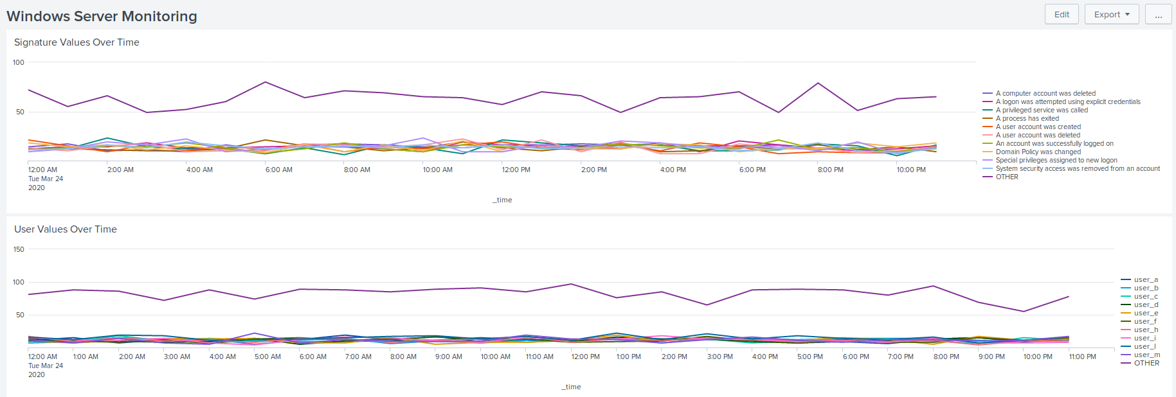
Dashboards—Windows

Slide 14
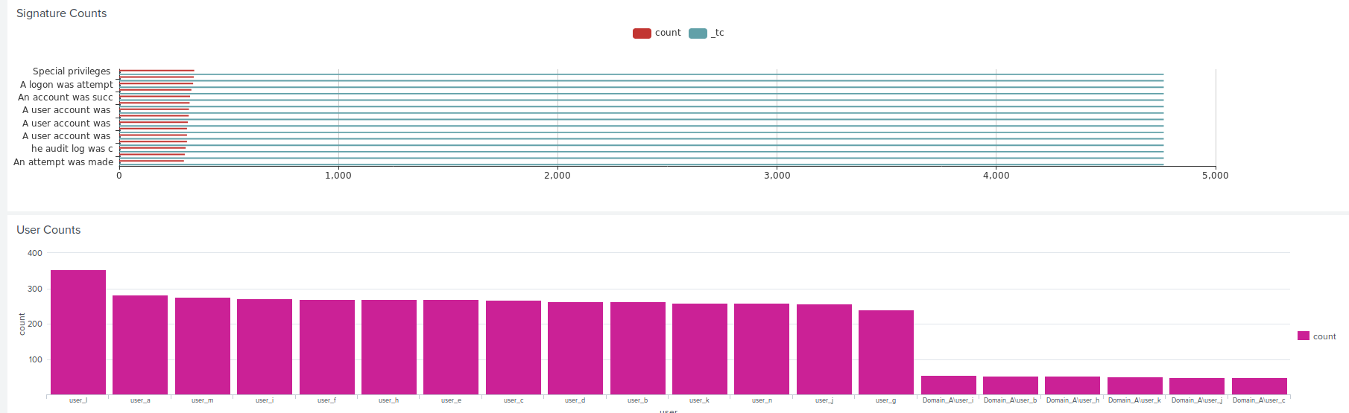
Dashboards—Windows

Slide 15
Apache Logs
‹#›

Slide 16
Reports—Apache
Designed the following reports:
Report Name | Report Description
HTTP Methods | Shows the type of HTTP methods used by users on VSI’s website.
Referrer Domains | Chart of domains where users were directed from to VSI’s website.
HTTP Response Codes | Indicates if a certain HTTP response completed or not.

Slide 17
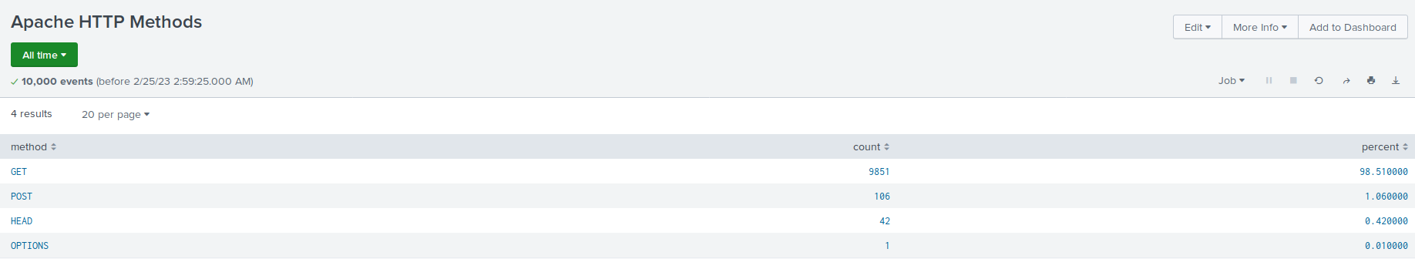
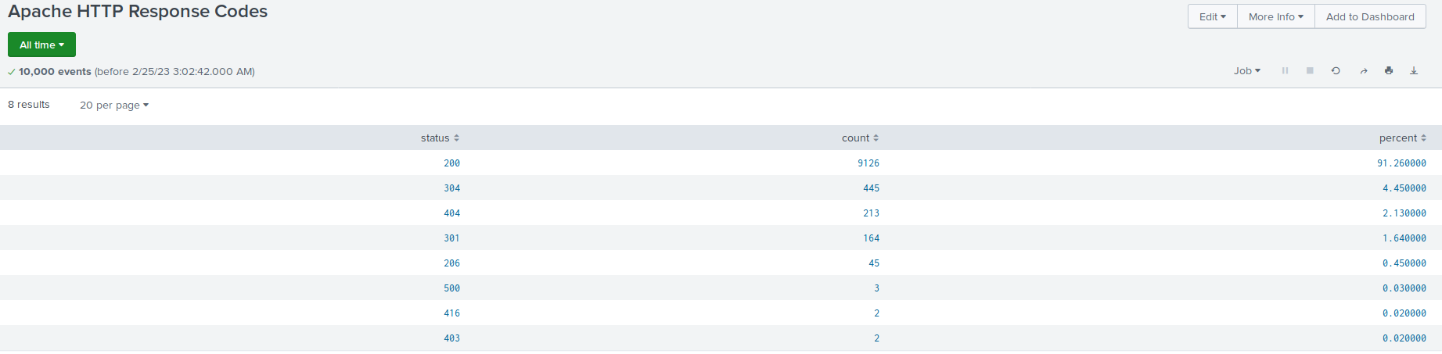
Images of Reports—Apache

Slide 18
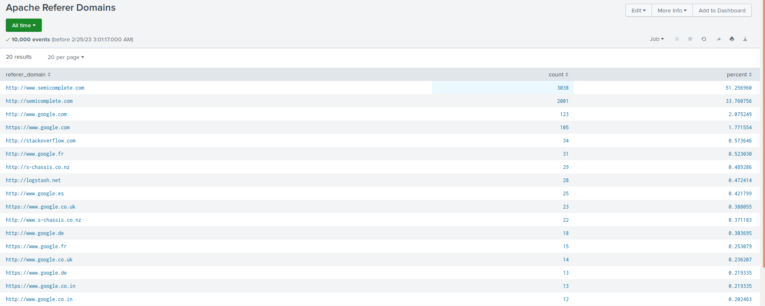
Images of Reports—Apache

Slide 19
Alerts—Apache
Designed the following alerts:
Alert Name | Alert Description | Alert Baseline | Alert Threshold
Increase on International Traffic | Indicates if an usual increase of internal traffic has been detected. | 135 | 150
Depending on business popularity, network traffic can increase or decrease. Meaning that traffic can vary daily. While it tends to average between 87-135 counts per hour, it is okay to assume that it can increase a little bit past that. So an alert would be set at 150.

Slide 20
Alerts—Apache
Designed the following alerts:
Alert Name | Alert Description | Alert Baseline | Alert Threshold
POST Alert | Excessive POST methods used by users. | 7 | 10
According to the logs, it is very rare for users to send POST HTTP requests to the Apache’s server. It can be used to create or modify user accounts on the server by users. But if there is a sudden increase of POST requests, it indicates very suspicious activity that a user should not be doing.

Slide 21
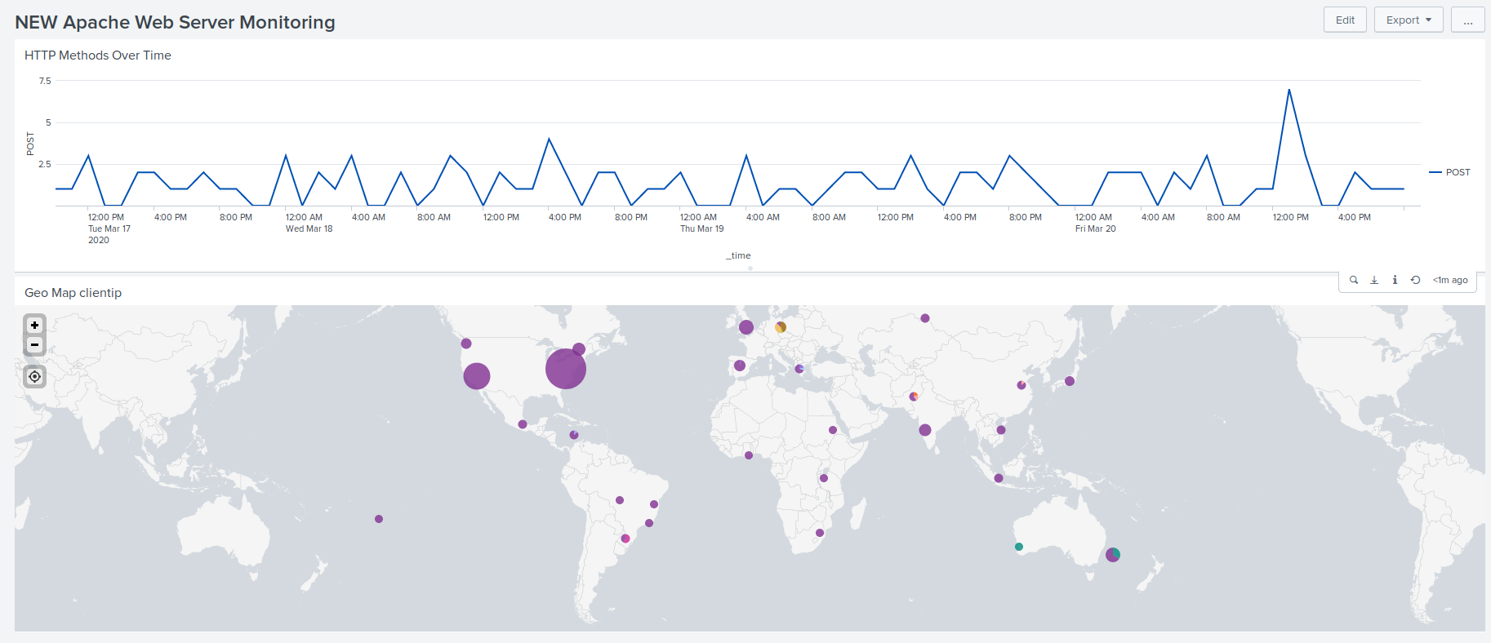
Dashboards—Apache

Slide 22
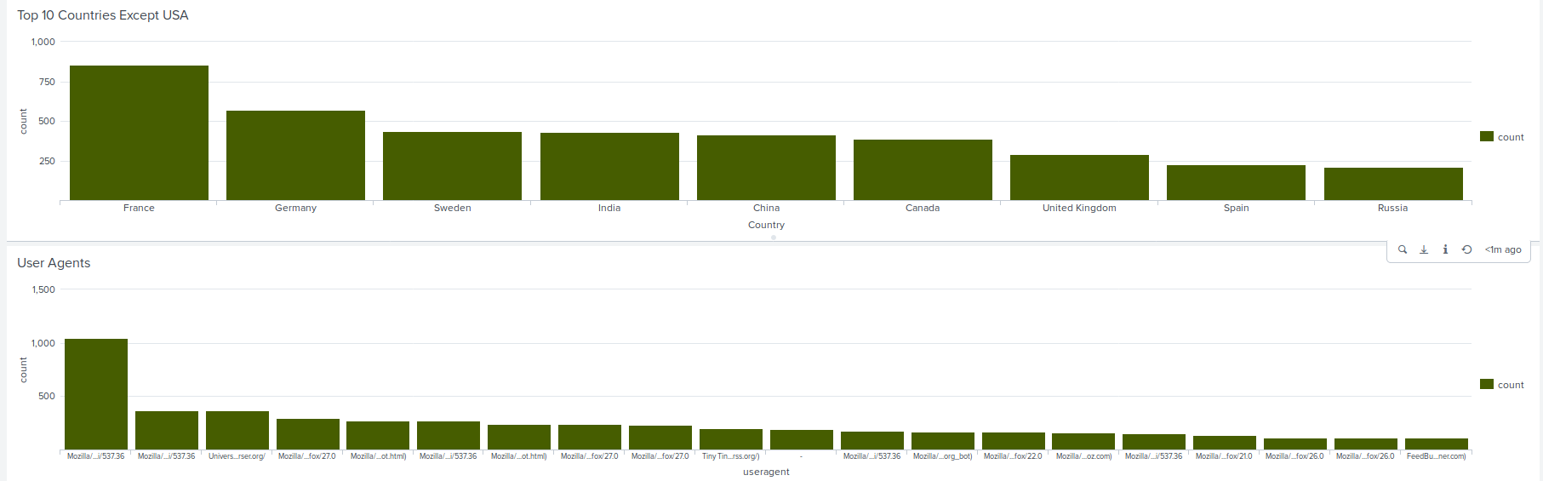
Dashboards—Apache

Slide 23
Attack Analysis
‹#›

Slide 24
Attack Summary—Windows
Summarize your findings from your reports when analyzing the attack logs.
Throughout the attack logs, there was an increase and decrease on counts throughout the network:
Large increase of unusual logins which indicates a password spraying attack and/or brute force attack.
Decrease of failed logins possibly due to weak login credentials.
Many user accounts were deleted than usual.
Password resets were attempted on user accounts that have been locked out.

Slide 25
Attack Summary—Windows
Summarize your findings from your alerts when analyzing the attack logs. Were the thresholds correct?
By comparing both logs, it was indicated from the alerts that a large amount of company network traffic increased. There were multiple signatures of successful account logins, multiple reset password attempts for locked out accounts, and many deleted user accounts.
There was an increase of signatures on the user account “user_l”. It could indicate that the user has weak login credentials and the attacker was able to figure them out (by using commonly known hacking tools).

Slide 26
Attack Summary—Apache
Large jump on POST methods. This method is used to send data to a server and appears to be exploited to cause damage to the server. This could potentially indicate why users across the globe were not able to access the website as much. Successful attacks can be indicated by looking at the increased number of HTTP response codes of 200.
There was also a large increase of international activity from Ukraine. This could indicate that either the attacker used a VPN or was actually located there and hired to execute the attack.The alert was triggered when the threshold reached more than 150 counts of international traffic. The normal baseline would be around less than 130 since that is what the normal past day-to-day log averages. However, the alert was triggered due to having 730 counts of web traffic at 6PM and 1,415 counts at 8PM on March 25, 2020.

Slide 27
Attack Summary—Apache
Summarize your findings from your dashboards when analyzing the attack logs.
With the attack logs, there was a noticeable, drastic jump of POST requests that started around 7:30 PM of a maximum of 1,296 counts. This shows around what time the attack was started on the server.
The refer domain chart decreased. Indicating that the website wasn’t accessible with ease.

Slide 28
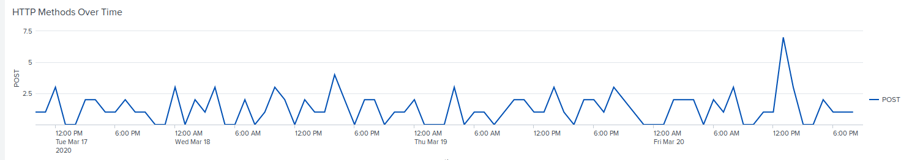
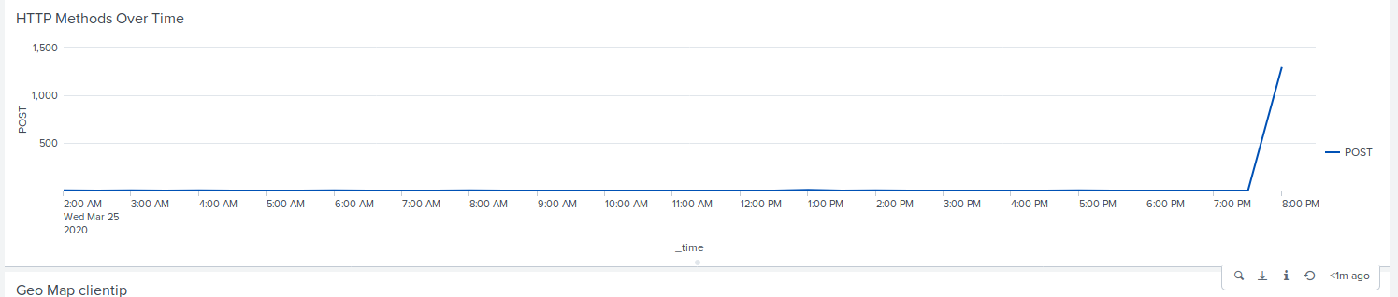
Attack Summary—Apache

Slide 29
Summary and Future Mitigations
‹#›

Slide 30
Project 3 Summary
What were your overall findings from the attack that took place?
Heavy international activity (possible DDoS attack or Buffer Overflow), large amounts of 200 response codes, excessive Windows signatures, etc.
To protect VSI from future attacks, what future mitigations would you recommend?
To help mitigate future attacks for the company, the company should invest on a “kill switch” to cut off network access in the event excessive activity is shown on a network.
Force users to use strong, complex, login credentials (passwords) to avoid user accounts from being compromised.
Turn off ping request so that the server doesn’t get overwhelmed with many requests.

